Slide 1
Data Science Salary Analysis
Matthew Townsend
Project

Slide 2
Objective
Analyze factors that impact salaries.
Focus on experience, location, and job role.
Identify trends in the data science job market.

Slide 3
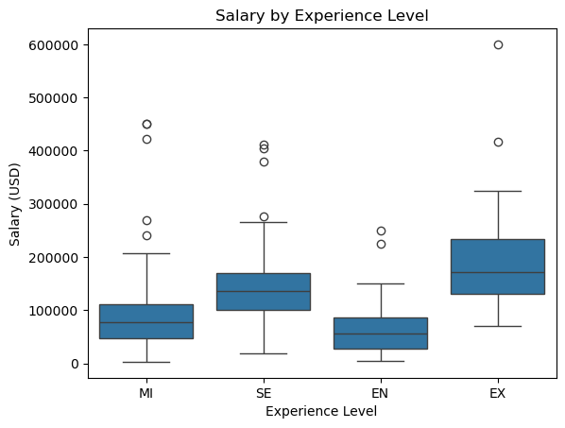
Salary by Experience Level
Executive level earns the most.
Senior level follows.
Entry level earns the least.

Slide 4
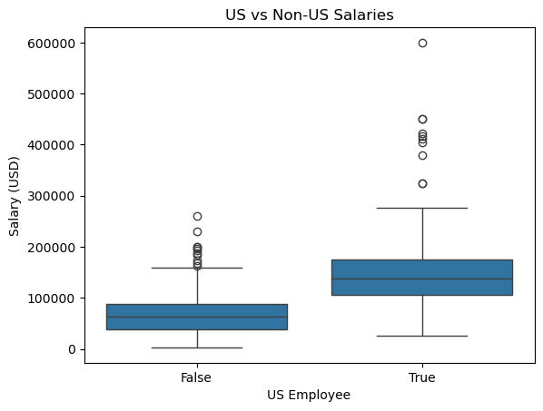
US vs Non-US Salaries
US salaries are significantly higher.
Wider salary range in the US.
Location plays a major role.

Slide 5
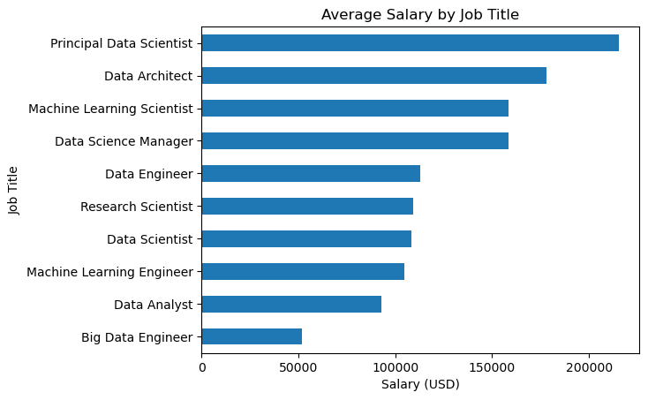
Salary by Job Title
Senior and leadership roles earn the most.
Machine learning roles are highly paid.
Analysts earn less than specialized roles.

Slide 6
Recommendations
Experience significantly increases salary.
US-based roles offer higher pay.
Specialized roles lead to higher compensation.

